Slide 1




Catherine Kiernan, Winter Warmth Engagement Officer at Wimbledon Guild
Dominic Regan, Age UK Merton Information & Advice Officer
Giles Read, Thinking Works Director
Notes:
(Suggest go on mute if possible.) 20 minute presentation- show on my screen, with a video at the end. Chance for questions at the end.

Slide 2
What is Warm & Well in Merton?
Raising awareness of the importance of staying healthy and active year-round, including in the current warmer weather
A partnership between Merton Council, Wimbledon Guild, Age UK Merton and Thinking Works
Running to March 2021
Notes:
Some of you may remember we spoke to you about staying warm in winter which is another of our aims.

Slide 3


What does Warm & Well offer?
Information and advice
  Age UK & Wimbledon Guild provide free, confidential telephone advice on pensions, welfare benefits, social care, health, housing, transport and more
Financial support for individuals
  Wimbledon Guild can provide grants for eligible people in Merton to help with fuel costs, bedding and food
  Currently providing supermarket vouchers and completing assessments over the phone

Slide 4
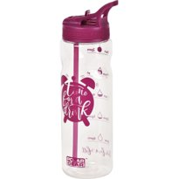
What does Warm & Well offer?
Information on staying well in warmer weather
  Online talks for community groups with tips on how to stay well in warmer weather and information on local services
  A free water bottle to ensure you keep hydrated and information on local services available to you in current circumstances
Thinking Works energy saving telephone advice
  Free telephone or email advice on saving on your energy bills
  See if you might be eligible for grants from the Mayor of London of up to £4000 for insulation and heating works
  For residents aged over 65, OR with a long-term health condition or disability OR on a low income
Notes:
Thinking Works are currently giving advice by telephone, email and letter on:
Specialist advice on lowering your heating bills whilst keeping warm
Billing advice including advice on unit rates, tariffs and how to switch
Assessments for grants from the Mayor of London of up to £4000 for insulation and heating works – now open but only urgent cases are being actioned
Advice and referrals for debt and financial assistance (though this would likely be referring back to WG or Age UK)
Assessments for Thames Water discounts such as Water Sure Plus
Although winter feels a long way off, now is the time to ensure you are prepared by paying less on your bills and that any issues are sorted well before it starts getting cold.

Slide 5
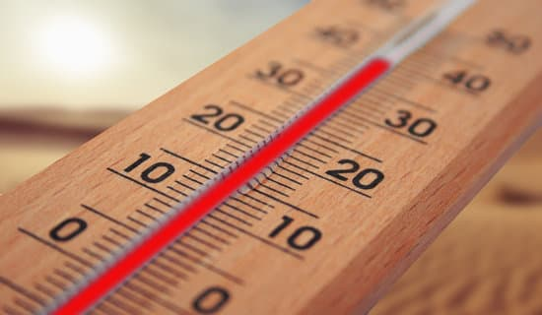
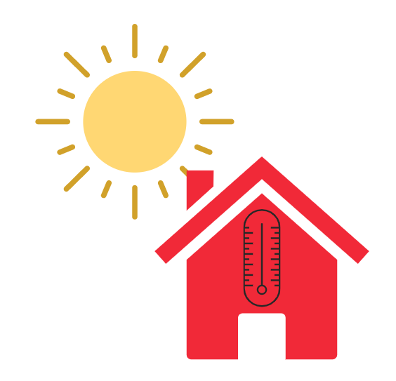
Why is keeping cool in a heatwave important?
The past decade was the warmest on record
The main causes of illness during a heatwave are respiratory and cardiovascular diseases
Other illnesses: heat cramps, heat rash, heat oedema, heat syncope, heat exhaustion, heatstroke
Older people and people with certain health conditions are at higher risk for both complications from COVID-19 and the heat
People are spending a lot more time at home
-1 in 5 homes in England are prone to overheating
Notes:
The past decade was the warmest on record- last year a new temperature record for the UK was set at 38.7C (Cambridge)
The main causes of illness during a heatwave are respiratory and cardiovascular diseases
Other specific heat-related health effects and illnesses include: heat cramps, heat rash, heat oedema, heat syncope, heat exhaustion, heatstroke
It is particularly important to be aware of these risks:
Older people and people with certain health conditions are at higher risk for both complications from COVID-19 and heat related harm
People are spending a lot more time at home
-1 in 5 homes in England are prone to overheating
We still have much to learn about how coronavirus (COVID-19) affects the body, but both heat and COVID-19 infections put a strain on the heart and lungs, the kidneys and are linked with inflammation in the body. Clinical vulnerabilities that have been linked with worse outcomes from COVID-19 that are also risks for heat related harms are: • high blood pressure • chronic obstructive pulmonary disease • heart and lung conditions (cardiovascular disease) • conditions that affect the flow of blood in the brain (cerebrovascular disease) • kidney disease
South-facing top-floor flats are particularly prone to overheating
Heat syncope- dizziness and fainting, due to dehydration, widening of blood vessels, cardiovascular disease & certain medication
Heat cramps- caused by dehydration and loss of electrolytes, often following exercise
Heat oedema- mainly in the ankles due to fluid retention and widening of blood vessels (often from standing too long on a hot day)
Heat exhaustion (which can lead to heat stroke)- nausea, irritability, dizziness, muscle cramps, feeling faint, headache, fatigue, excessive sweating, high body temperature
Heat stroke- hot dry skin or profuse sweating, confusion, loss of consciousness, seizures, very high body temperature
Increased blood flow to the skin cools the body by radiating heat, leading to heat rash- small red itchy papules
When body temperature rises, the body stimulates sweat glands, dilates blood vessels (this causes more heat to be carried by the blood to the skin, where it can be lost to the air) and increases heart rate

Slide 6
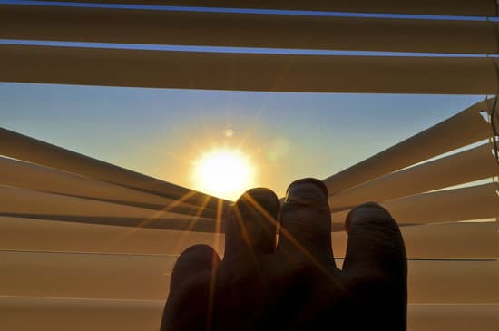
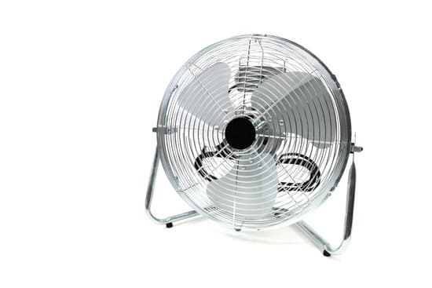
Keeping cool in a heatwave
Keeping your home cool:
Close curtains that receive morning or afternoon sun, but be aware of metallic blinds and dark curtains
Keep the windows closed when it’s cooler inside, and open when it is cooler outside
Have your loft and cavity walls insulated
Use electric fans if below 35°C- don’t aim the fan directly at the body or use a fan if anyone in the home is unwell with symptoms of COVID-19
Turn off lights and electrical equipment that aren’t in use
Notes:
Close curtains that receive morning or afternoon sun, but be aware that metallic blinds and dark curtains can make a room hotter.
Keep the windows closed when it’s cooler inside than out. Open the windows when it is cooler outside- eg at night.
Have your loft and cavity walls insulated – this keeps the heat in when it is cold and out when it is hot
Use electric fans if the temperature is below 35°C, but do not aim the fan directly at the body as this can cause excess dehydration. Do not use a fan if anyone in the home is unwell with symptoms of coronavirus (COVID-19)
Turn off lights and electrical equipment that aren’t in use
Try to get the air flowing around your home

Slide 7
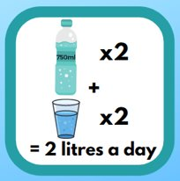
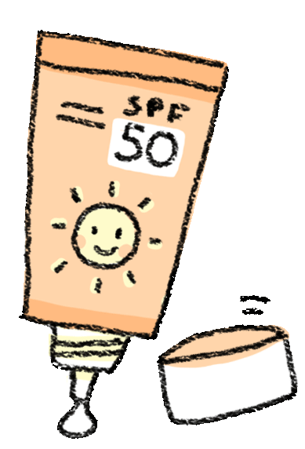
Keeping cool in a heatwave
Staying well in the heat
Drink at least 8 glasses (2 litres) a day of water and more if it is hot . We are providing 750ml water bottles- fill these twice and drink at least 2 other drinks.
Keep an eye on the weather forecast
Avoid extreme physical exertion or keep it for cooler parts of the day
Check how medication is stored- if below 25C, keep in the fridge when it’s very hot
Use suncream of at least SPF30 and apply it regularly, making sure you don’t miss a spot!
Notes:
Staying well in the heat
Drink plenty of water to avoid dehydration. Drink at least 8 glasses a day (2 litres) and more if it is hot.
Keep an eye on the weather forecast
Avoid extreme physical exertion. If you can’t avoid strenuous outdoor activity, such as sport, DIY or gardening, keep it for cooler parts of the day – for example, in the early morning or evening
Check how you’re storing your medication- most should be kept below 25C so it might be best to keep in the fridge when it’s very hot
Use suncream of at least SPF30 and apply it regularly, making sure you don’t miss a spot!
Drink plenty of fluids: water, lower fat milks and tea and coffee are good options. Fruit juice, smoothies and soft drinks do count towards your fluid intake, but can be high in sugar. Limit fruit juice or smoothies to a combined total of 150ml a day and swap sugary soft drinks for diet, sugar-free or no added sugar varieties.
Added information not to read but to be aware of:
Sometimes people you care for do not have a sense of how much they're drinking.
To help them:
make sure they drink during mealtimes
make drinking a social thing, like "having a cup of tea"
offer them food with a high water content – for example, soups, ice cream or jellies, or fruits like melon
Diorolyte or sports drinks:
Dioralyte- the NHS suggests oral rehydration sachets from the pharmacist can be useful in replacing salts lost through vomiting or diarrhoea. If you're being sick or have diarrhoea and are losing too much fluid, you need to put back the sugar, salts and minerals that your body has lost.
Your pharmacist can recommend oral rehydration sachets. These are powders that you mix with water and then drink.
https://www.nhs.uk/conditions/dehydration/
Sports drinks- the NHS does not mention these as a cure for dehydration, however the research I have done seems to show there is some debate, but these may be helpful after high intensity workouts of longer duration, to replace salts or for endurance athletes. I haven’t found any research to say these are best drank regularly, and also to keep an eye out for the sugar content as these may not be very healthy. On the whole it seems water is best but energy drinks may help in moderation if exercising for a long duration.
Though water should always be your first drink of choice, there may be certain scenarios where a sports drink is exactly what your body needs.
If you’re participating in high-intensity workouts lasting more than 45 minutes to an hour, sports drinks may help replenish your body’s electrolyte stores better than water. Recommendations also show that people whose sweat contains high levels of sodium (you may notice sweat stains or rings on your skin or clothing) may also benefit from re-hydrating with sports drinks.
Endurance athletes, like marathon runners or long-distance cyclers, may also benefit from drinking sports drinks because of the increased fluid loss from such intense exercise.
In both of these scenarios, athletes should make sure their sports drinks contain both carbohydrates and electrolytes.

Slide 8
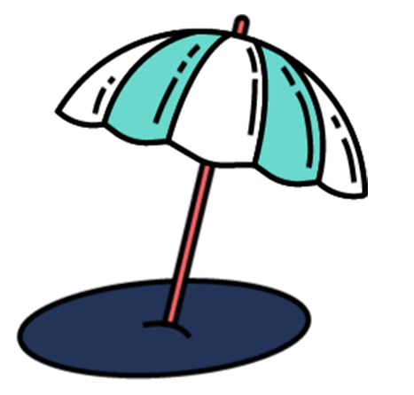

Keeping cool in a heatwave
Best ways to stay cool
Don’t spend too long outside at the hottest part of the day (11am-3pm)
Wear light coloured, lightweight cotton clothing
Avoid getting hot but if you do, give your body a break from the heat
It may be cooler out in the garden in the shade
Move to a cooler part of the house, especially for sleeping
Put a damp cloth or a splash of water on the back of your neck or have a cool bath or shower.
Notes:
Best ways to stay cool
Don’t spend too long outside at the hottest part of the day (11am-3pm) and create shade in your garden where you can
Wear light coloured, lightweight cotton clothing to keep cooler
It is important for your health to avoid getting hot in the first place. If you do get hot, it is important to give your body a break from the heat
It may be cooler out in the garden in the shade than it is inside an overheated building
Move to a cooler part of the house, especially for sleeping
A damp cloth or a splash of water on the back of your neck is better at cooling you down than a fan. You could also have a cool bath or shower.

Slide 9
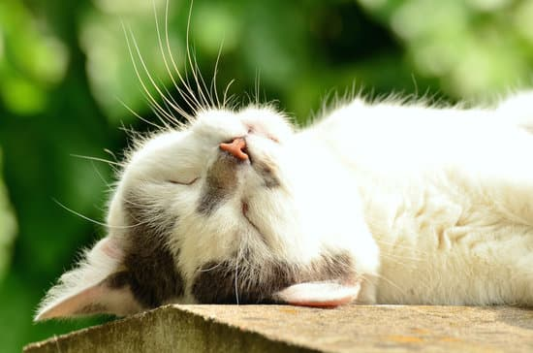
Keeping cool in a heatwave
Signs of becoming unwell:
Dehydration (thirst, confusion, cramps, feeling weak)
Heat exhaustion (headaches, dizziness, nausea, fast pulse). Lie down in a cool room, drink plenty of water and cool yourself with a splash of water
Heat exhaustion could lead to heat stroke- falling unconscious and seizures. Call 999 immediately
If you know it’s going to be hot and you might struggle, ask someone to check on you
Or check on someone else you think might struggle in the heat
Notes:
Signs of becoming unwell:
Dehydration (thirst, confusion, cramps, feeling weak)
Heat exhaustion (headaches, dizziness, nausea, fast pulse). If you feel unwell, lie down in a cool room, drink plenty of water and cool yourself with a splash of water
Heat exhaustion could lead to heat stroke- symptoms are falling unconscious and seizures. Call 999 immediately if you think someone might have a heatstroke
If you know it’s going to be hot and you might struggle, ask someone to check on you
Or check on someone else you think might struggle in the heat. Check neighbours and family members know how to keep cool in warmer weather and have everything they need

Slide 10

Heath & Wellbeing at Home
Staying active is important for our health to help us:
  Get a good night's sleep
  Keep our spirits up
  Reduce risk of falls and fractures
  Stay at a healthy weight
  Reduce risk of heart attack, stroke, diabetes & some cancers
  Prevent many health conditions from worsening
Try to keep moving throughout the day
Chair exercises can be found online, A Guide to Staying Active at Home during the coronavirus outbreak:
https://issuu.com/niftyfoxcreative/docs/active___home_booklet.finalcolour
Sports England has published a list of resources for people with disabilities and health conditions:
  https://www.sportengland.org/jointhemovement#get_active_at_home
Notes:
Try to keep moving throughout the day:
Ways to build activity into your day- regular stretches, gardening, cleaning, going up and down the stairs
We would recommend having a look at some of these links, there are chair exercises and other useful tips in the Guide to Staying Active At Home During the Coronavirus Outbreak.
Sport England
Sport England has published a list of online physical activity resources for people with a disability or a long-term health condition. These resources are specifically adapted to suit different conditions, including:
diabetes
multiple sclerosis (MS)
chronic fatigue syndrome (CFS), chronic pain and fibromyalgia,
wheelchair users

Slide 11


Heath & Wellbeing at Home
Prioritise your sleep- going to bed and waking up at a regular time
Keep your mind active- crosswords, puzzles, letter writing
Stay connected with phone calls, letters, emails, texts, online platforms
Eating a healthy, balanced diet is important:
  Try to eat healthier snacks
  Buy frozen, dried and canned fruit & veg without added sugar
  Plan your meals when shopping & stick to regular mealtimes
Notes:
Sleep- give yourself time to wind down before bed
Eat a balanced diet that includes a variety of:
Fruit & veg
Starchy foods (bread, cereals, potatoes, pasta or rice)
Beans, pulses, fish & meat
2 portions of fish a week- 1 oily
Oils & spreads (choose unsaturated and use in moderation)
Eating a healthy balanced diet is the best way to ensure you and your family get the nutrients you need and maintain a healthy weight. Being indoors more often than usual may mean you change your eating habits, snack more, and do less physical activity. If you are less active than you usually would be, try not to eat more than you need; particularly snacks such as biscuits, cakes and crisps which can be high in calories.
When you shop for food, you may want to think about:
buying healthier snacks – opt for fruit, lower fat and lower sugar yoghurt, plain rice cakes, lower sugar popcorn, sugar-free jelly and malt loaf
buying frozen, dried and canned fruit and veg without added salt and sugar – these longer-lasting alternatives to fresh fruit and vegetables still count as part of your 5 A Day
planning your meals – before you buy your groceries, it can be helpful to plan your meals, so you can ensure that you are getting the balanced diet you need

Slide 12
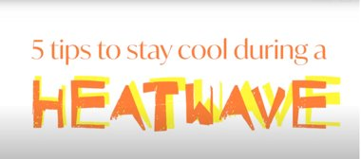
Video
Notes:
I'm just going to change the screen to show you the video- please let me know if you can't see or hear this.

Slide 13
Contact details
Contact Details
For information and advice on benefits, care, housing options, transport, leisure:
For general enquiries, or referrals to Thinking Works or grants:
Age UK Merton advice@ageukmerton.org.uk 020 8648 5792
Wimbledon Guild ckiernan@wimbledonguild.co.uk 0208 739 2931
Or visit: www.warmandwellinmerton.co.uk
Notes:
These are our contact details- I will send these slides by email to Charlotte, along with some extra information on local services and staying cool, that can be shared with you afterwards
We suggest any individual referrals or questions on individual circumstances are best asked here.

Slide 14

Notes:
Does anyone have any general questions on staying well in warmer weather?

